Slide 1
Working in Groups
 | 2015
CompSci 345 / SoftEng 350
Reshmi
rrav495@aucklanduni.ac.nz

Slide 2
Assignment 2
Groups can be across tutorials.
Each group should ideally have mix of skills
(e.g. Psychology, Designing, Programming).
If you don’t have a group yet, make one on Picassa ☺
Points of contact are:
  Reshmi: rrav495@aucklanduni.ac.nz
  Kreshnik: kpir004@aucklanduni.ac.nz

Slide 3
Why have groups?
Employers want team skills.
Allows work on large/complex projects.
Enables you to work with people from different backgrounds.
Exchange of information enables you to up skill.
Get feedback
Groups usually outperform individuals.

Slide 4
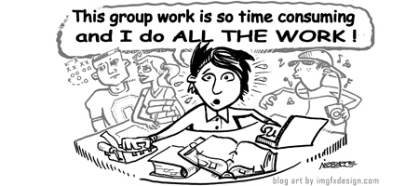

Slide 5
Why not have groups?
Needs cooperation
Conflicting ideas
Everything requires justification
Free riders
Personality clashes
Slow you down

Slide 6
Exercise
Individually come up with one strategy for each of the following:
Someone who is dominating discussions and taking up too much of the group's time
A member of the group who never speaks
A member of the group who is always putting down others
Then as a group, decide on the best one for each

Slide 7
Stages of Group Development
Norming
Forming
Performing
Adjourning
Storming

Slide 8
Stages of Group Development
Forming :
Group members come together
People are excited, anxious, uncertain and looking for support.
2. Storming :
Critical phase as magnitude of work dawns upon group.
Conflicts, struggle for control and panic are highlights of this phase.

Slide 9
The RCC rule
Respect – the view of others.
Communicate- keep communications open and transparent.
Compromise – be prepared to compromise
Don’t hold back! If you feel someone isn’t pulling their weight, say something so they can improve their contribution.
Group meeting
Contact a tutor (Kreshnik or myself)
If all else fails we contact Beryl , Craig or Jim

Slide 10
Stages of Group Development
3. Norming :
An equilibrium is reached.
Work distribution takes place.
Trust and confidence in the groups abilities.
Respect
2. Performing :
The task execution phase.
Project gains momentum.
3. Adjourning
End of project/task.
Team disbanded.

Slide 11
Conflicts
Conflicts are a part and parcel of group work.
Usually arise from individuals not following the RCC rule.
Ways of Dealing with Conflicts
Give and be prepared to take constructive criticism.
Thrash out issues in a team meeting.
Be prepared to take on the role of a mediator.
Do not be a silent spectator!
Conflict Resolution Process
Group meeting
Contact a tutor (Safurah or Moiz)
If all else fails we contact Beryl or Jim

Slide 12
Tips for Success
Form ideas at home, and bring them to group
Divide workload from the start
Set agenda/goals from the start
Enjoy!

